Slide 1

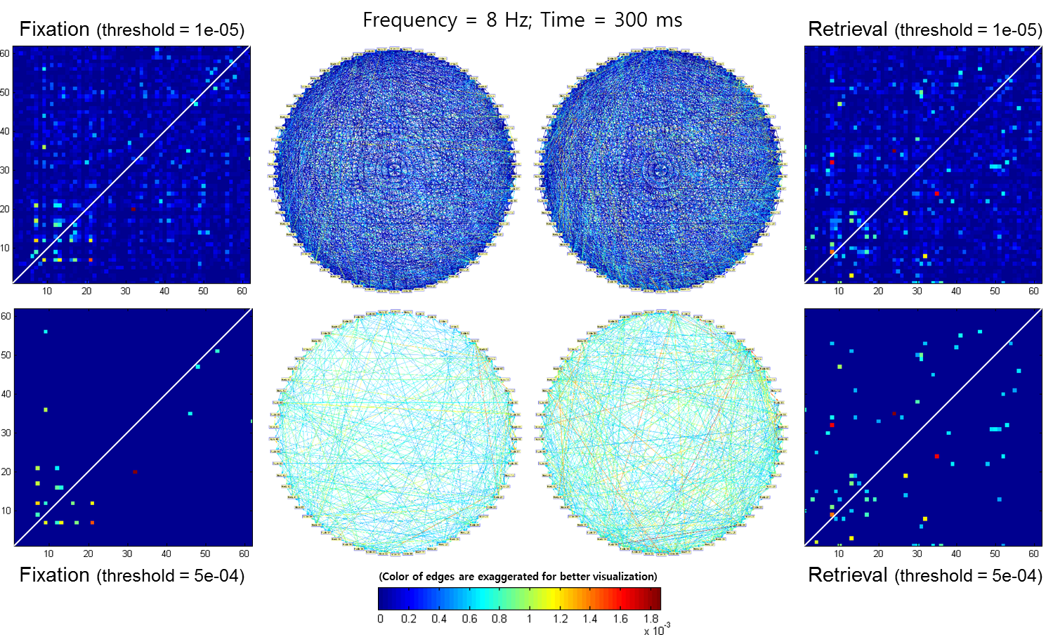
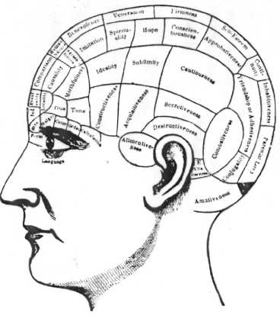
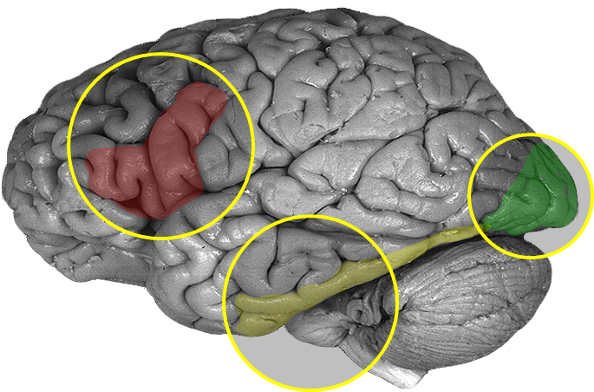
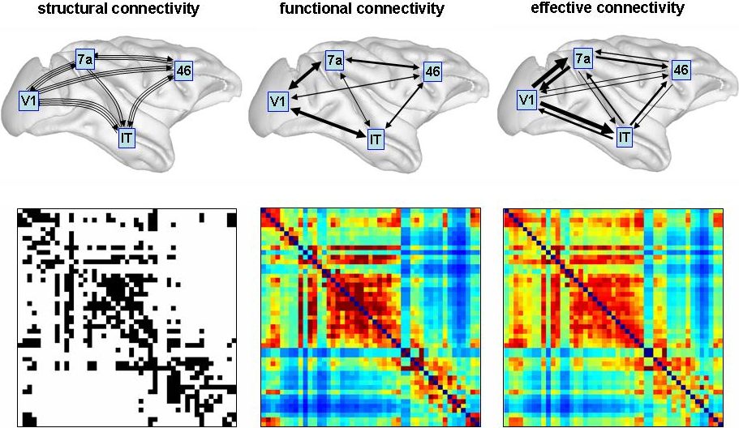
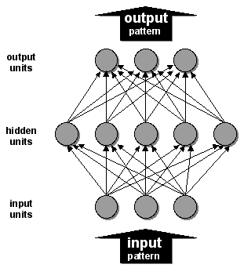
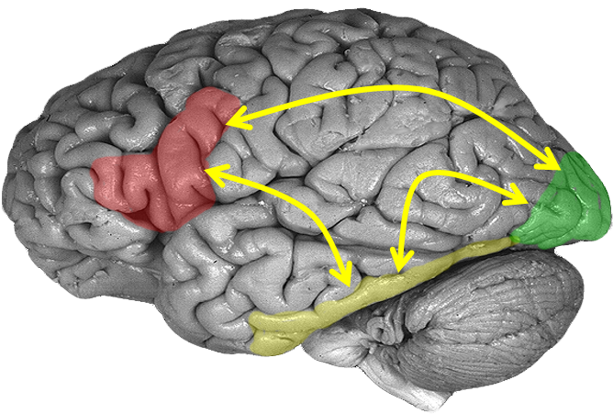
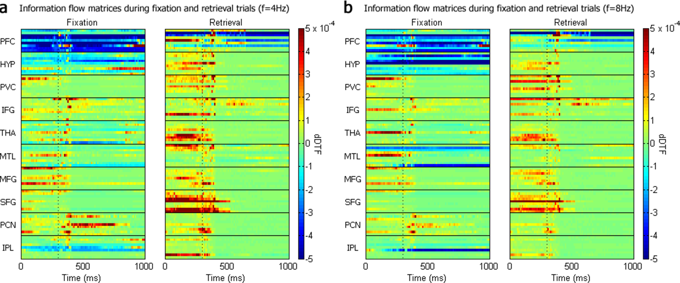
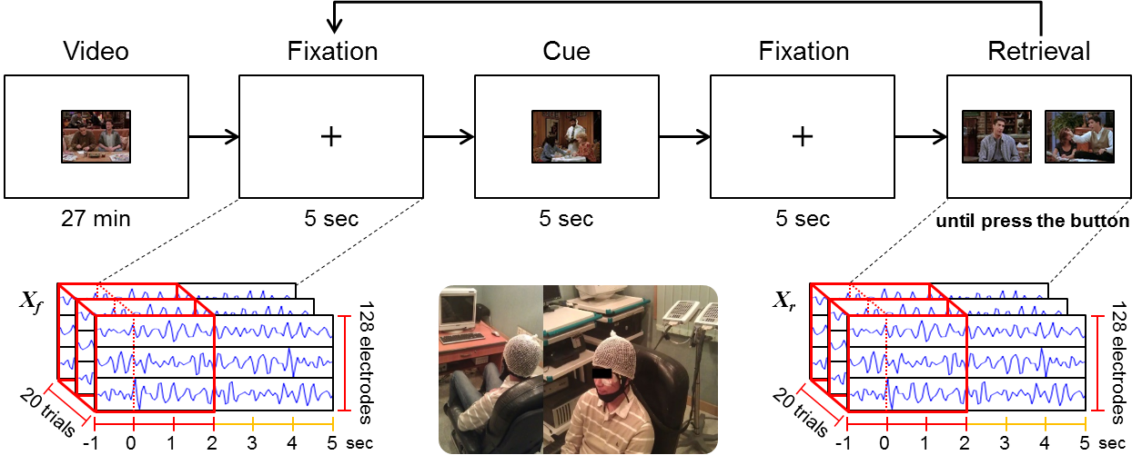



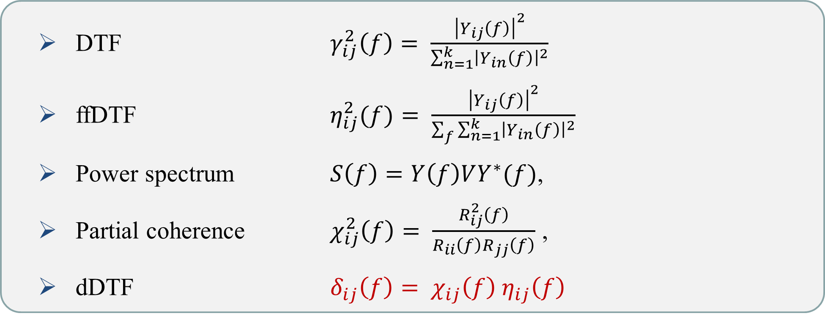
Analysis of information flow network
during episodic memory retrieval
Chung-Yeon Lee¹ and Byoung-Tak Zhang^{1,2,3,4}
School of Computer Science & Engineering ¹, Seoul National University
Graduate Program in Brain Science ², Cognitive Science ³, Bioinformatics⁴ , Seoul National University
cylee@bi.snu.ac.kr, btzhang@bi.snu.ac.kr
Backgrounds
Experimental Results
Functional integration focuses on networks of the interactions among the specialized areas exist in the cortex → Connectivity
Effective connectivity can explain causal/directed influences between neural activities and regional effects in terms of interregional connectivity → information flows
Information flow network during non-retrieval and retrieval tasks
Retrieval shows densely connected network and stronger interactions
Localizationism
Functional Segregation
Connectionism
Functional Integration
※ Sources from Boebinger & Knight 2013, Methods for Dummies; Hanneke den Ouden 2009, SPM Course at Zurich; Sporns 2007, Scholarpedia
Research Goals
Information flows are significantly increased among the 10 active regions
To study the information flows of the human brain network
During episodic memory retrieval
Partial and direct information within the human brain
Based on effective connectivity measured from EEG
Source localization for estimating the activity of the neuronal sources
The strength and spectro-anatomical patterns of the inter-areal interactions
Direct directed transfer function and time-varying MVAR model
Graph theoretical analysis for Topological interactions across the brain regions
Methodology
Behavioral tasks and EEG acquisition setup
The episodic memory retrieval game tasks after watching a video
EEGs were sampled at 1 KHz using an EEG cap equipped with 128 electrodes
Networks of the effective connectivity shows:
Asymmetrical features: PVC─Temporal/Occipital regions vs. Frontal gyrus
Hub node: the superior frontal gyrus (SFG)
IPL
PCN
IPL
PCN
HYP
SFG
THA
HYP
SFG
THA
MTL
MFG
IFG
MTL
MFG
IFG
PFC
PVC
PFC
PVC
Direct directed transfer function (dDTF)
A measure based on the transfer function matrix between channels
A combination of partial coherence and directed transfer function (DTF)
Sliding-window MVAR model (500 ms window length, 10 ms step size)
Concluding Remarks
Information flows during episodic memory retrieval
between frontal cortex, medial temporal, parietal and occipital lobes
Globally interconnected effective connectivity network
SFG acted a hub in the network during memory retrieval
SFG is a key component of the neural network of memory process
The highest level of executive processing (Boisgueheneuc et al., 2006)
Asymmetric information flows between brain regions
PVC-temporal/occipital regions vs PVC-frontal regions
PCN→SFG (non retrieval) vs SFG→PCN (retrieval)
The dual process model of attention of memory (Cabeza, 2008)
DTF $γ_{ij}^{2}\left(f\right)= \frac{{\left|Y_{ij}\left(f\right)\right|}^{2}}{\sum_{n=1}^{k}{{\left|Y_{in}\left(f\right)\right|}^{2}}}$
ffDTF $η_{ij}^{2}(f)= \frac{{\left|Y_{ij}\left(f\right)\right|}^{2}}{\sum_{f}{\sum_{n=1}^{k}{{\left|Y_{in}\left(f\right)\right|}^{2}}}}$
Power spectrum $S\left(f\right)=Y\left(f\right)VY^{∗}(f)$,
Partial coherence $χ_{ij}^{2}\left(f\right)= \frac{R_{ij}^{2}\left(f\right)}{R_{ii}\left(f\right)R_{jj}\left(f\right)}$ ,
dDTF $δ_{ij}\left(f\right)= χ_{ij}\left(f\right) η_{ij}\left(f\right)$
Biointelligence Lab, Seoul National University | http://bi.snu.ac.kr

